Slide 1
Arrays and Lists
Lecture # 2
Dr. Sharaf Hussain

Slide 2
Arrays
A one-dimensional array is composed of multiple sequential elements stored in contiguous bytes of memory and allows for random access to the individual elements.
Array contains fixed number of elements
Individual elements within the array can be accessed directly form their index values.
Occupy less memory as compared to python list
Internal processing is faster than python lists

Slide 3
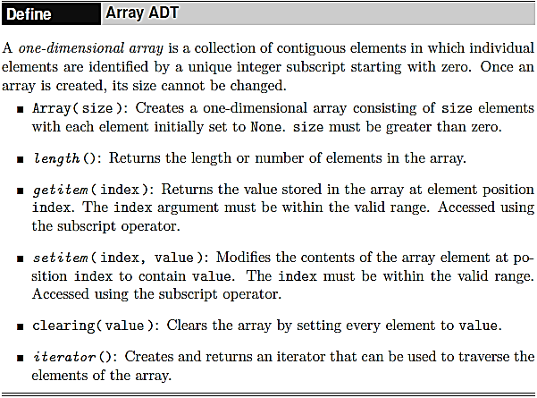
Array ADT

Slide 4
Array Class in Python
# Fill a 1-D array with random values, then print them, one per line.
from array import Array
import random
# The constructor is called to create the array.
valueList = Array( 100 )
# Fill the array with random floating-point values.
for i in range( len( valueList ) ) :
valueList[ i ] = random.random()
# Print the values, one per line.
for value in valueList :
print( value )

Slide 5
Array Class in Python
#Count the number of occurrences of each letter in a text file.
from array import Array
# Create an array for the counters and initialize each element to 0.
theCounters = Array( 127 )
theCounters.clear( 0 )
# Open the text file for reading and extract each line from the file
# and iterate over each character in the line.
theFile = open( 'atextfile.txt', 'r' )
for line in theFile :
for letter in line :
code = ord( letter )
theCounters[code] += 1
# Close the file
theFile.close()
# Print the results. The uppercase letters have ASCII values in the
# range 65..90 and the lowercase letters are in the range 97..122.
for i in range( 26 ) :
print( "%c - %4d %c - %4d" % \
(chr(65+i), theCounters[65+i], chr(97+i), theCounters[97+i]) )

Slide 6
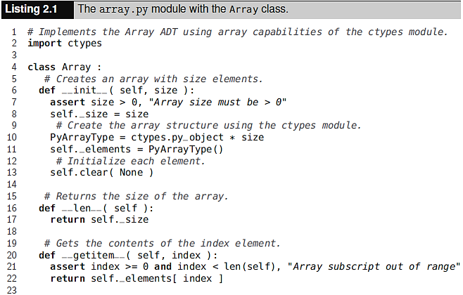
Implementing the Array

Slide 7
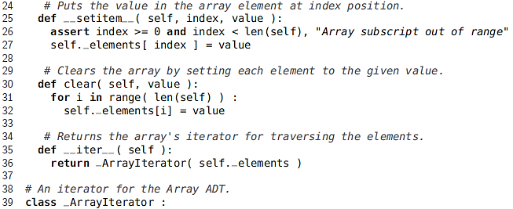
Implementing the Array

Slide 8
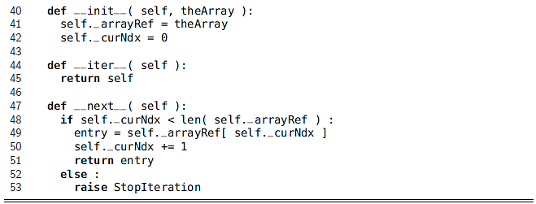
Implementing the Array

Slide 9
Using the Array
import random myarray = Array(10) print("myarray legth is: ",len(myarray)) for i in range(len(myarray)): item =random.random() print("{} --> {:.2f}".format(i,item)) myarray[i]=item print ("myarray initialized upto {} values".format(len(myarray))) aindex = int(input("Enter the index value of array element: ")) print("The array index '{}' contains item {:.2f}".format(aindex,myarray[aindex]))

Slide 10
Using the Array - output
myarray length is: 10
0 --> 0.26
1 --> 0.21
2 --> 0.12
3 --> 0.12
4 --> 0.76
5 --> 0.73
6 --> 0.74
7 --> 0.86
8 --> 1.00
9 --> 0.48
myarray is initialized upto 10 values
Enter the index value of array element: 9
The array index '9' contains item 0.48

Slide 11
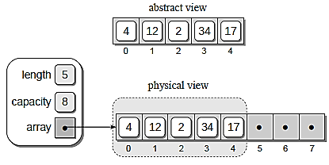
The Python List
Python's list structure is a mutable sequence container that can change size as items are added or removed.
It is an abstract data type that is implemented using an array structure to store the items contained in the list.
For example
pyList = [ 4, 12, 2, 34, 17 ]

Slide 12
The Python List – Appending item
Appending an item
pyList.append( 50 )
Appending more items
pyList.append( 18 )
pyList.append( 64 )
pyList.append( 6 )
when the third statement is executed, the array will have to be expanded to make room for value 6.
To allow for the expansion of the list, the following steps have to be performed:

Slide 13
The Python List – Appending item
To allow for the expansion of the list, the following steps have to be performed:
a new array is created with additional capacity,
the items from the original array are copied to the new array,
the new larger array is set as the data structure for the list, and
The original smaller array is destroyed.

Slide 14
The Python List – Extending list
A list can be appended to a second list using the extend() method as shown in the following example:
pyListA = [ 34, 12 ]
pyListB = [ 4, 6, 31, 9 ]
pyListA.extend( pyListB )

Slide 15
The Python List – Inserting items
An item can be inserted anywhere within the list using the insert() method. In the following example:
pyList.insert( 3, 79 )
the array elements are shifted to the right one at a time, traversing from right to left,
the new value is then inserted into the array at the given position,
the result after inserting the item.

Slide 16
The Python List – Removing items
An item can be removed from any position within the list using the pop() method.
pyList.pop( 0 ) # remove the first item
a copy of the item is saved;
the array elements are shifted to the left one at a time, traversing left to right and
the size of the list is decremented by one.

Slide 17
The Python List - List Slice
Slicing is an operation that creates a new list consisting of a contiguous subset of elements from the original list.
The original list is not modified by this operation.
Instead, references to the corresponding elements are copied and stored in the new list.
aSlice = pyList[2:4]

Slide 18
Two-Dimensional Arrays
Two-dimensional array arrange data in rows and columns.
The individual elements are accessed by specifying two indices, one for the row and one for the column, [i,j].

Slide 19
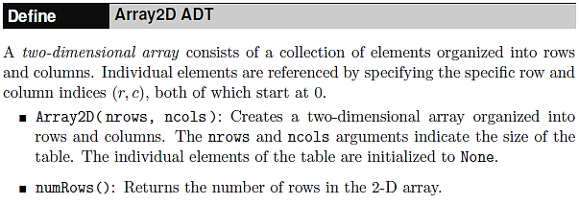
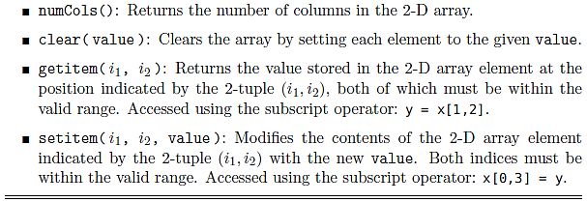
Two-Dimensional Arrays - ADT

Slide 20
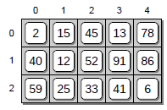
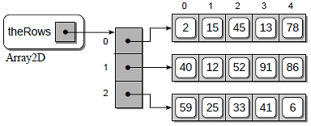
Implementing the 2-D Array
an array of arrays to store the elements of a 2-D array.
Store each row of the 2-D array within its own 1-D array.
Then, another 1-D array is used to store references to each of the arrays used to store the row elements.

Slide 21
Implementing the 2-D Array
from myarray import Array
class Array2D:
def __init__(self, numRows, numCols): self._theRows = Array(numRows) for i in range(numRows): self._theRows[i] = Array(numCols) def numRows(self): return len(self._theRows) def numCols(self): return len(self._theRows[0]) def clear(self, value): for row in range(self.numRows()): self._theRows[row].clear(value)

Slide 22
Implementing the 2-D Array
def __getitem__(self, ndxTuple): assert len(ndxTuple)==2, "Invalid number of array subscripts" row = ndxTuple[0] col = ndxTuple[1] assert row >= 0 and row < self.numRows() \ and col >= 0 and col < self.numCols(),\ "Array subscript out of range" the1dArray = self._theRows[row] return the1dArray[col] def __setitem__(self, ndxTuple, value): assert len(ndxTuple)==2, "Invalid no of array subscripts" row = ndxTuple[0] col = ndxTuple[1] assert row >=0 and row < self.numRows() \ and col >= 0 and col < self.numCols(), \ "Array subscript out of range." the1dArray = self._theRows[row] the1dArray[col] = value

Slide 23
Implementing the 2-D Array
##------------------------------------- ## Implementation ##------------------------------------- twoDArray = Array2D(3,3) twoDArray.clear(0) for i in range(twoDArray.numRows()): print('') for j in range(twoDArray.numCols()): twoDArray[i,j] = int(input('enter value %d,%d = '%(i,j))) print(‘Your 2D-Array is here:') for i in range(twoDArray.numRows()): print('') for j in range(twoDArray.numCols()): print(twoDArray[i,j],end =" ")

Slide 24
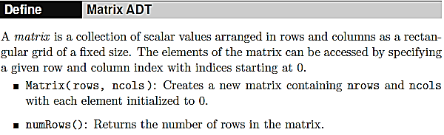
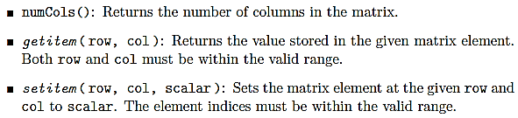
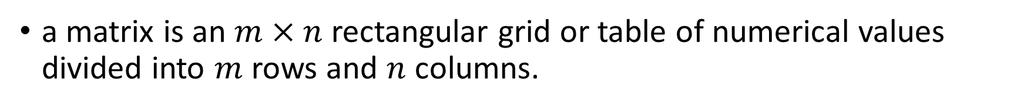
The Matrix Abstract Data Type
a matrix is an $m×n$ rectangular grid or table of numerical values divided into $m$ rows and $n$ columns.

Slide 25
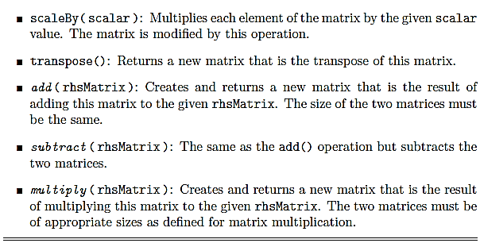
The Matrix Abstract Data Type
a matrix is an $m×n$ rectangular grid or table of numerical values divided into $m$ rows and $n$ columns.

Slide 26
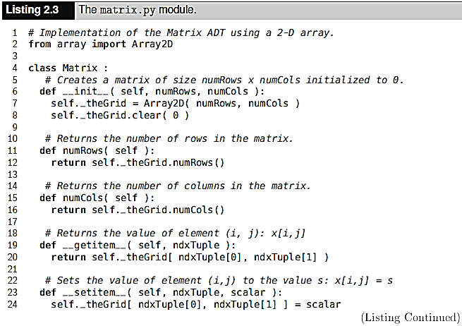
Implementing the Matrix

Slide 27
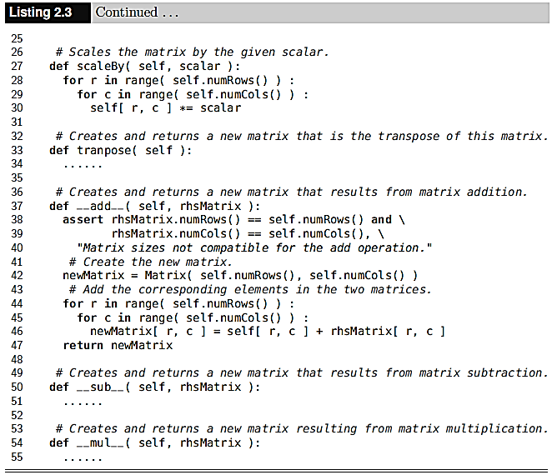
Implementing the Matrix

Slide 28
Application: The Game of Life
If a cell is alive and has either two or three live neighbors, the cell remains alive in the next generation. The neighbors are the eight cells immediately surrounding a cell: vertically, horizontally, and diagonally.
A living cell that has no live neighbors or a single live neighbor dies from isolation in the next generation.
A living cell that has four or more live neighbors dies from overpopulation in the next generation.
A dead cell with exactly three live neighbors results in a birth and becomes alive in the next generation. All other dead cells remain dead in the next generation.

Slide 29
Application: The Game of Life

Slide 30
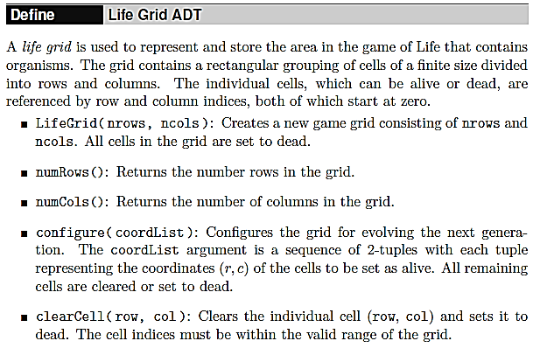
The Game of Life - Designing a Solution

Slide 31
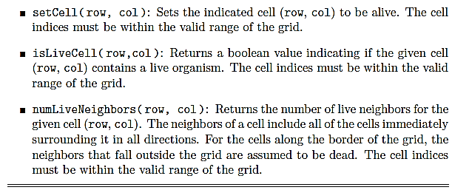
The Game of Life - Designing a Solution

Slide 32
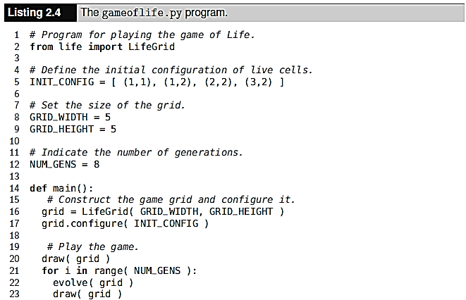
The Game of Life - Designing a Solution

Slide 33
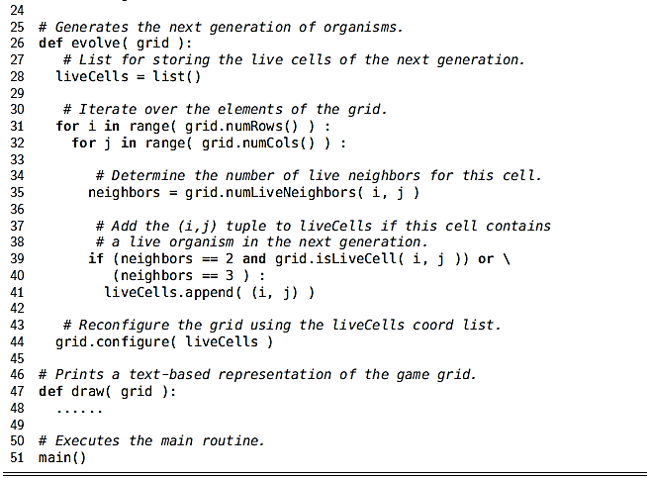
The Game of Life - Designing a Solution

Slide 34
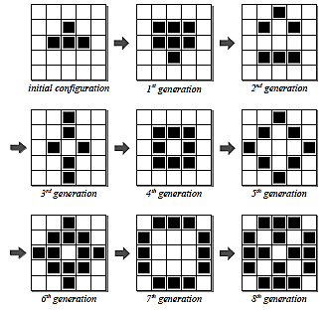
The Game of Life - Designing a Solution

Slide 35
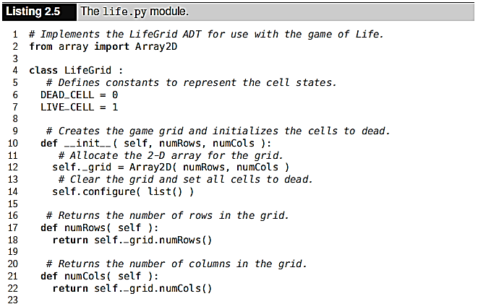
The Game of Life - Implementation

Slide 36
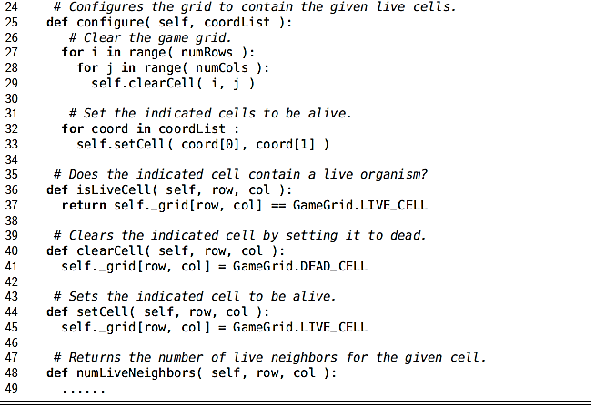
The Game of Life - Implementation

Slide 37
Assignment – 1
Implement Matrix class that can perform following operations,
Addition
Subtraction
Scaling
Transpose
Multiplication
Inverse of Matrix

Slide 38
Assignment – 1
Implement the numLiveNeighbors() method of the LifeGrid class.
Complete the implementation of the gameoflife.py program by implementing the draw() function. The output should look similar to the following, where dead cells are indicated using a period and live cells are indicated using the @ symbol.
Modify the gameoflife.py program to prompt the user for the grid size and the number of generations to evolve.
Due Date:
Submission: Microsoft Teams

